Slide 1
CAVA - NOODLES & COMPANY DEAL
A STRATEGIC ACQUISITION PROPOSAL
May 2026
NYSE: CAVA
NASDAQ: NDLS

Slide 2





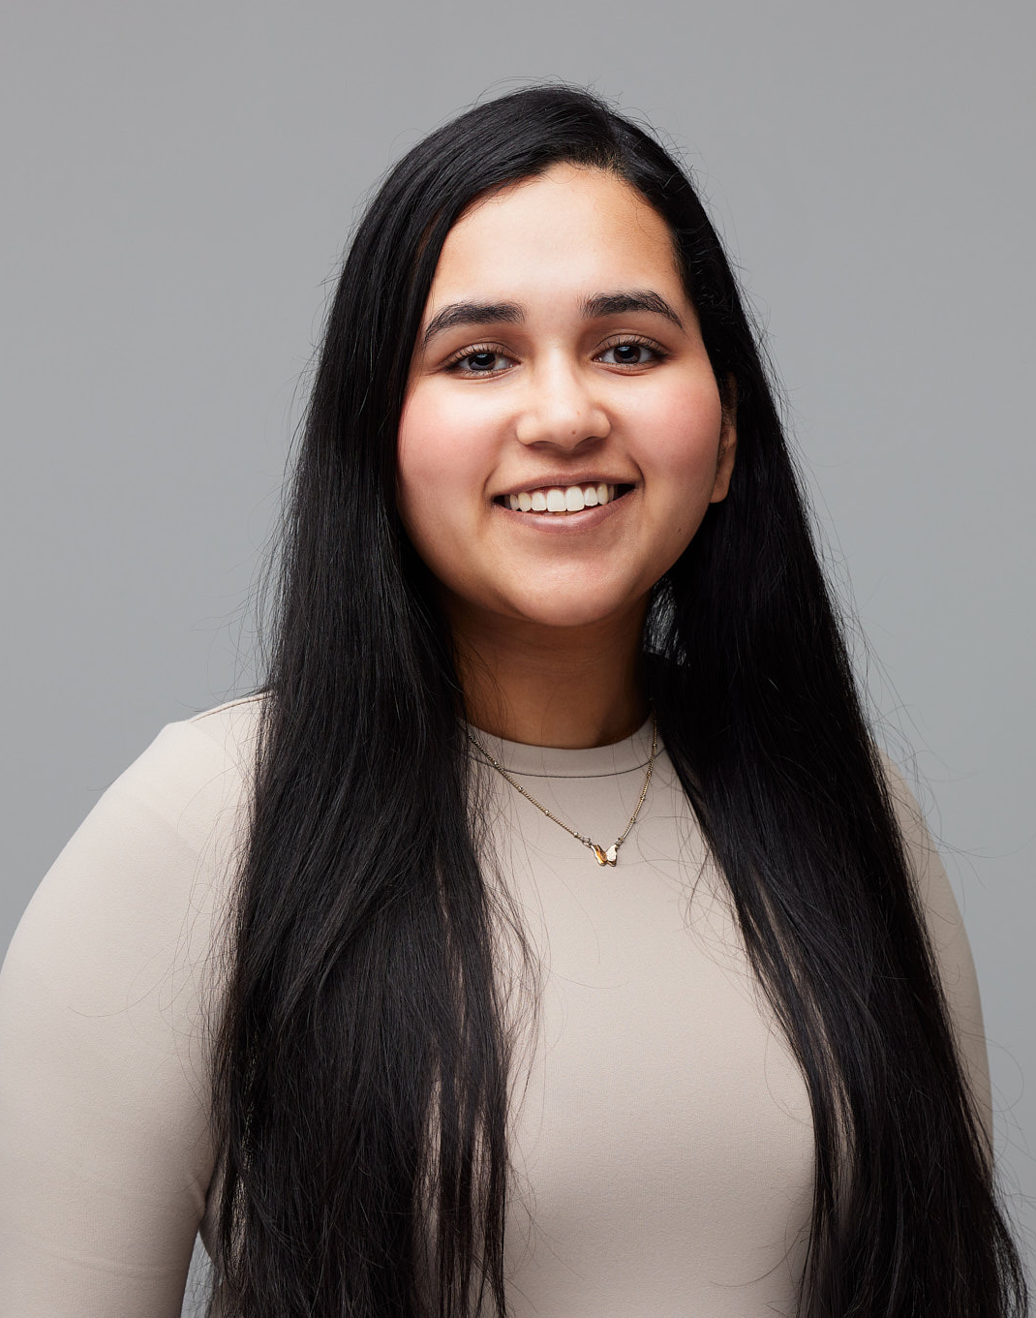
ADVISORY TEAM
Snigdha Thakkar
Harshul Shetty
Venkatesh Pathak
Niranjan Keskar
Hritik Jaipuriya
Riya Gupta
M.S. Finance
M.S. Finance
M.S. Finance
M.S. Finance
M.S. Finance
M.S. Finance
TEAM | 2

Slide 3
CONTENTS
01
Executive Summary
11
Offer Price & Premium
02
Acquirer Profile - CAVA Group
12
Sources of Synergies
03
Target Profile - Noodles & Company
13
Synergy Ramp & Present Value
04
Industry Landscape
14
Deal NPV
05
Strategic Rationale
15
Financing Strategy
06
Standalone Valuation - CAVA
16
Pro-Forma Capital Structure
07
Standalone Valuation - Noodles
17
Pro-Forma WACC
08
Comparable Companies Analysis
18
Pro-Forma Income Statement
09
Precedent Transactions
19
Post-Merger Stock Price Impact
10
Football Field Valuation
20
Conclusion & Recommendation
CONTENTS | 3

Slide 4
EXECUTIVE SUMMARY
THE DEAL
STRATEGIC RATIONALE
• 100% all-cash acquisition of NDLS by CAVA
• Convert 320 NDLS company-owned restaurants to CAVA
• $16.39/share offer (36.0% premium over $12.05 unaffected)
• Replicates the proven Zoë's Kitchen conversion playbook
• $96.5M equity purchase price; absorbs $105.6M NDLS debt
• ~½ the cost of greenfield builds, faster ramp to AUV
VALUE CREATION
DEAL NPV & STOCK IMPACT
• $144.3M after-tax PV of synergies vs. $25.6M required
• +$113.9M NPV to CAVA shareholders
• 5.6× coverage of premium paid
• +$30.4M NPV to NDLS shareholders
• Capex savings ($136M) + faster-opening benefit ($46.7M)
• +5.4% implied share price appreciation ($79.40 → $83.67)
Source: Group analysis; CAVA 10-K FY2025; Noodles 10-K FY2025; team financial model
OVERVIEW | 4

Slide 5
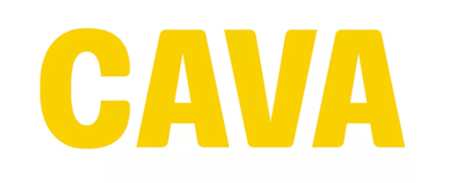
ACQUIRER PROFILE - CAVA GROUP
NYSE: CAVA
BUSINESS MODEL
• Fast-casual Mediterranean concept offering chef-curated, customizable bowls & pitas with fresh ingredients and bold flavors
$1.18B
439
• Hybrid revenue model: restaurant sales + consumer-packaged goods (CPG) - differentiated from pure-play peers
FY2025 REVENUE
RESTAURANTS (28 STATES + DC)
• Company-owned restaurants (no franchising); strong unit economics with high AUV trajectory
22.4%
$393M
• Currently in early-stage expansion phase - significant runway versus mature comp set (Chipotle, Shake Shack)
YOY REVENUE GROWTH
CASH & INVESTMENTS
• Demonstrated execution: 22.4% revenue growth and improving operating margins despite aggressive footprint expansion
EARLY-STAGE EXPANSION | ~2,400-STORE TAM
Source: CAVA Group 10-K, FY2025; William Blair Equity Research, December 2025
PROFILE | 5

Slide 6
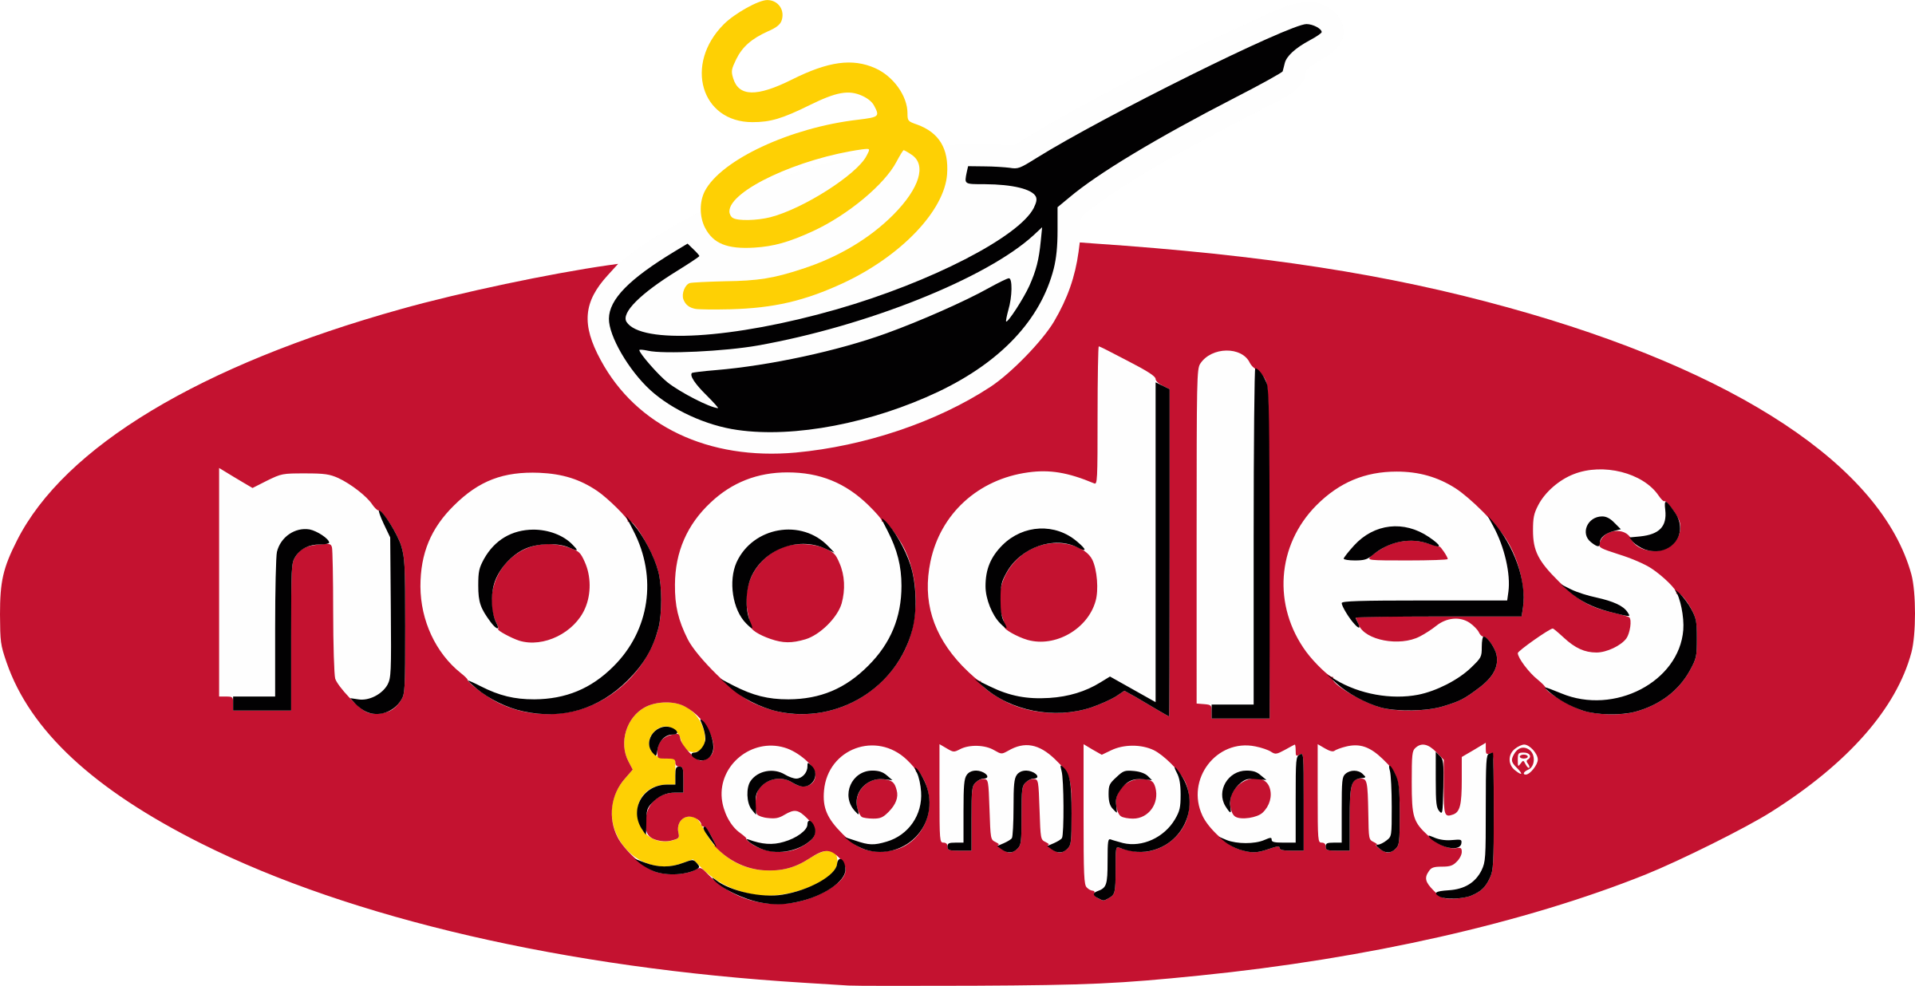
TARGET PROFILE - NOODLES & COMPANY
NASDAQ: NDLS
BUSINESS MODEL
• Globally-inspired fast-casual noodle and pasta concept; long operating history but mature growth profile
$12.05
$71.0M
• Mix of company-owned (320) and franchised restaurants; company-owned base is the conversion target
UNAFFECTED SHARE PRICE (5/8/26)
STANDALONE EQUITY VALUE
• Deteriorating unit economics in recent years; limited organic growth runway
320
$105.6M
• Strategically valuable real estate footprint in established suburban trade areas with proven traffic
COMPANY-OWNED RESTAURANTS
EXISTING DEBT (ABSORBED)
• Existing kitchen infrastructure and dining-room footprints fit CAVA's Mediterranean format with modest reconfiguration
MATURE CONCEPT | VALUABLE SUBURBAN REAL ESTATE
Source: Noodles & Company 10-K, FY2025; Q1 2026 earnings release; team analysis
PROFILE | 6

Slide 7
U.S. FAST-CASUAL RESTAURANT INDUSTRY
GROWTH DRIVERS
• Rising demand for fresh, healthy, plant-based options
• Digital ordering, delivery, and contactless payment adoption
• Urbanization and busy professional lifestyles
• Menu diversification and technology-enabled customer engagement
RECENT FAST-CASUAL M&A
• RaceTrac → Potbelly (Sep 2025) - $550M EV, 19.0× EBITDA
• Darden → Chuy's (Jul 2024) - $622M EV, 10.6× EBITDA
• Jack in the Box → Del Taco (Dec 2021) - $585M EV
6.4% CAGR | $48.5B → $90.2B by 2035
The $48.5B U.S. fast-casual industry is growing at 6.4% CAGR, driven by fresh customizable meals and the convergence of convenience and health
Source: IBISWorld; William Blair Industry Research; Expert Market Research; team analysis
INDUSTRY | 7

Slide 8
STRATEGIC RATIONALE - WHY NOODLES, WHY NOW
Z
REPLICATE THE ZOË'S PLAYBOOK
R
REAL ESTATE ARBITRAGE
CAVA's prior Zoë's Kitchen conversion strategy in 2018 is the most direct precedent. Conversions were roughly half the cost of greenfield CAVA builds and ramped faster, validated by the CAVA S-1 (2023) and William Blair (2023).
320 company-owned NDLS sites sit in proven suburban trade areas with existing kitchen and dining-room infrastructure - ready-built locations that compress site-selection and construction timelines.
A
ACCELERATED EXPANSION
C
CAPITAL EFFICIENCY
Adds approximately 5 years of additional unit growth on top of CAVA's existing greenfield pipeline, without straining construction capacity or real estate sourcing teams during a critical scale-up phase.
Deploys $393M of low-yield idle cash into ROIC-accretive restaurant assets. Cash on the balance sheet earns minimal interest; converted stores generate CAVA's unit-level returns.
Source: CAVA S-1 (2023); William Blair (2023, 2025); RestaurantSpaces (2021); team strategic analysis
RATIONALE | 8

Slide 9
STANDALONE DCF VALUATION - CAVA
$57.42
DCF ASSUMPTIONS
Input | Value
WACC | 10.29%
Long-term Growth | 2.45%
Forecast Horizon | 15 years (2026–2040)
Terminal Method | Perpetuity + Exit Multiple
INTRINSIC VALUE / SHARE
vs. $79.40 Market - 28% OVERVALUED
5-YEAR FCF PROJECTION ($M)
KEY INSIGHTS
Year | Revenue | EBIT | Tax | D&A | CapEx | ΔNWC | FCF
2026E | 1,454 | 76 | (11) | 91 | (166) | (29) | (39)
2027E | 1,780 | 105 | (16) | 112 | (181) | (34) | (14)
2028E | 2,123 | 150 | (38) | 124 | (211) | (36) | (11)
2029E | 2,449 | 179 | (45) | 141 | (217) | (34) | 24
2030E | 2,884 | 216 | (54) | 165 | (228) | (46) | 53
• Capital efficiency: 2.57× asset turnover supports ROIC despite modest 7.4% profit margin
• No debt: zero interest-bearing debt; WACC equals cost of equity
• Terminal ROIC of ~18.7% reflects mature-state economics
• Market premium: $79.40 implies sustained outperformance beyond explicit forecast
Source: CAVA 10-K FY2025; team DCF model; broker estimates
VALUATION | 9

Slide 10
STANDALONE DCF VALUATION - NOODLES & CO.
$11.23
DCF ASSUMPTIONS
Input | Value
WACC | 8.01%
Long-term Growth | 2.45%
Forecast Horizon | 10 years (2026–2035)
Terminal Method | Perpetuity Growth
INTRINSIC VALUE / SHARE
vs. $12.05 Market — 7% OVERVALUED
5-YEAR FCF PROJECTION ($M)
KEY INSIGHTS
Year | Revenue | EBIT | Tax | D&A | CapEx | ΔNWC | FCF
2026E | 485 | 28 | (6) | 31 | (22) | (2) | 29
2027E | 501 | 32 | (7) | 32 | (23) | (2) | 32
2028E | 518 | 37 | (8) | 33 | (24) | (2) | 36
2029E | 534 | 41 | (9) | 34 | (24) | (2) | 40
2030E | 551 | 45 | (9) | 35 | (25) | (2) | 44
• Mature concept with limited organic revenue growth runway
• Deteriorating unit economics; ROI declining since 2022
• Stable but compressed cash flow with negligible reinvestment yield
• Standalone value supports a strategic sale; trade area real estate is the true asset
Source: Noodles & Company 10-K FY2025; team DCF model
VALUATION | 10

Slide 11
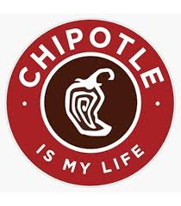
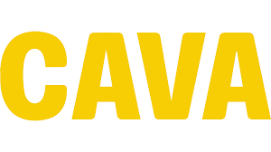
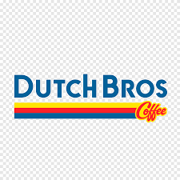
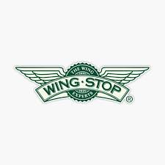

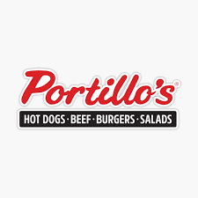
COMPARABLE COMPANIES - TRADING MULTIPLES
U.S. fast-casual and growth restaurant operators trading at premium multiples reflecting growth profiles
Company | Ticker | Price | Equity Value ($M) | EV ($M) | EV/Rev (LTM) | EV/EBITDA (LTM) | EV/EBITDA (NFY) | P/E (LTM)
Chipotle Mexican Grill | CMG | $35.08 | 45,689 | 44,443 | 3.73× | 19.12× | 19.14× | 29.36×
CAVA Group | CAVA | $93.63 | 11,044 | 10,646 | 9.02× | 79.03× | 58.10× | 162.27×
Dutch Bros | BROS | $52.43 | 8,627 | 8,775 | 5.36× | 37.22× | 24.01× | 102.77×
Wingstop | WING | $163.78 | 4,502 | 5,515 | 7.91× | 36.63× | 19.75× | 33.62×
Shake Shack | SHAK | $90.87 | 3,879 | 3,795 | 2.63× | 19.40× | 16.83× | 59.13×
Portillo's | PTLO | $5.40 | 408 | 751 | 1.03× | 8.55× | 7.82× | 35.99×
Median | — | — | — | — | 4.54× | 28.02× | 19.45× | 47.56×
Mean | — | — | — | — | 4.95× | 33.32× | 24.28× | 70.52×
Subj: Noodles & Co. | NDLS | $12.05 | 71 | 178 | 0.37× | 9.81× | 5.06× | n/m
IMPLIED VALUATION RANGE FOR NDLS
• At median EV/EBITDA of 28.02× (LTM) applied to NDLS adj. EBITDA: implied EV $510M - wildly above current $178M
• More realistic: applying 25th-percentile multiple (16.48× LTM) yields implied EV ~$300M → ~$33/share - supports premium thesis
• NDLS trades at 9.8× LTM EBITDA, deep discount to peer median - reflects mature growth profile and execution challenges
Source: Team Comparable Company Analysis (CapIQ data, May 2026); all multiples NTM where indicated
COMPS | 11

Slide 12
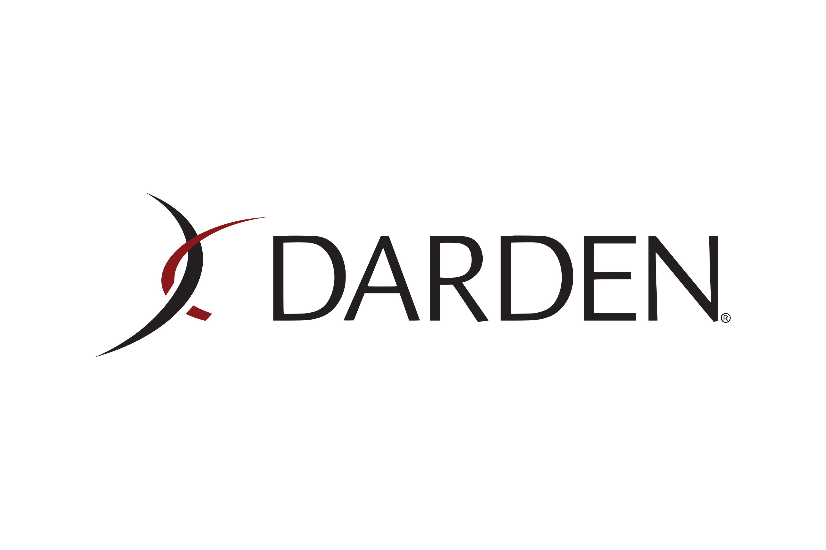
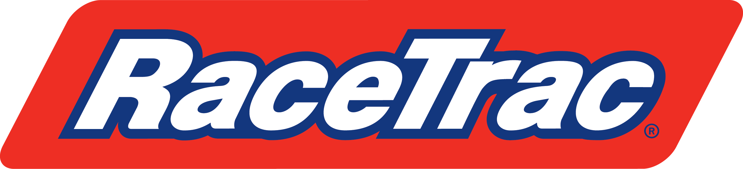

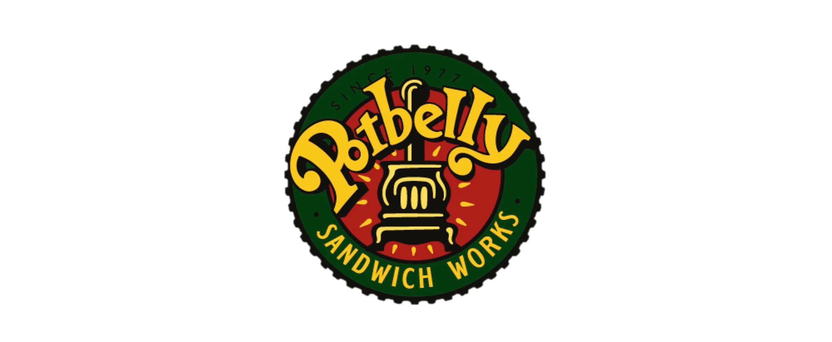
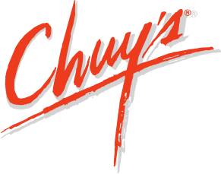
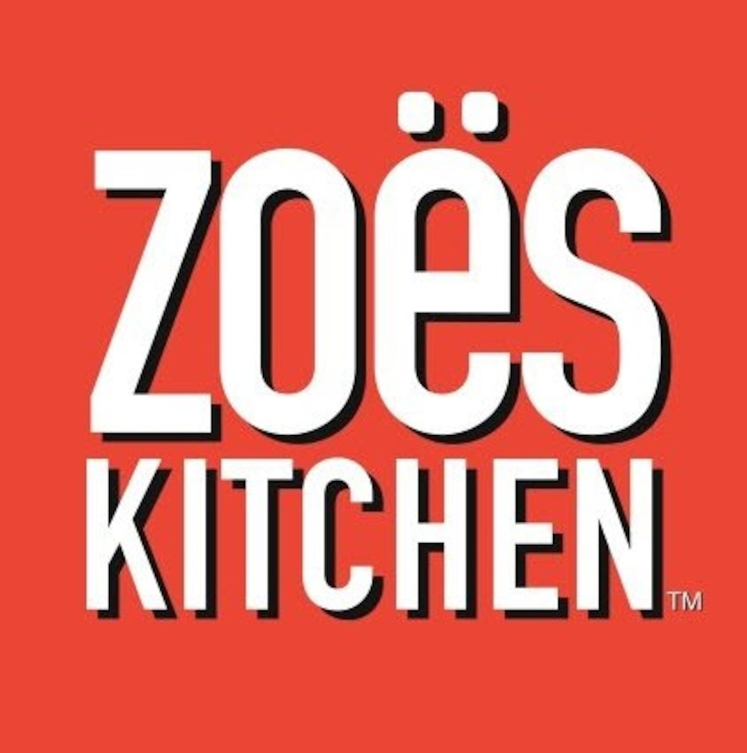
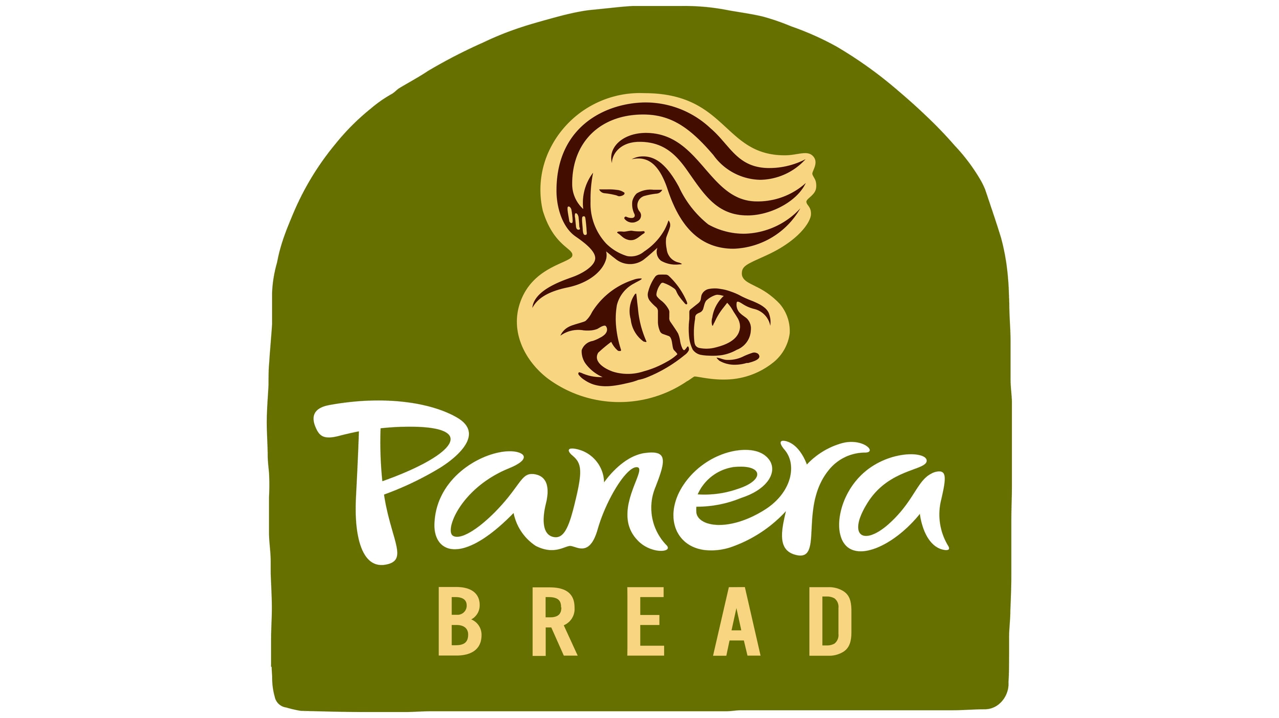
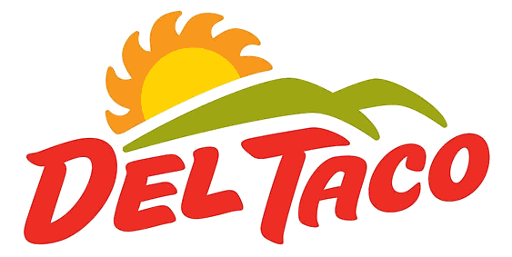
PRECEDENT TRANSACTIONS - FAST-CASUAL M&A
Strategic and financial transactions in fast-casual / casual dining benchmark this deal's economics
has acquired
has acquired
has acquired
has acquired
has acquired
Sep 2025
Jul 2024
Aug 2018
Dec 2020
Dec 2021
EV: $550M
EV: $622M
EV: $285M
EV: $7,490M
EV: $585M
EV/EBITDA: 19.0×
EV/EBITDA: 10.6×
EV/EBITDA: 17.4×
EV/EBITDA: 18.1×
EV/EBITDA: 10.96×
1-Day Prem: 32%
1-Day Prem: 48%
1-Day Prem: 33%
1-Day Prem: n/a
1-Day Prem: 66%
KEY TAKEAWAY - CAVA → ZOË'S KITCHEN IS THE DIRECT ANALOG
• Median fast-casual / casual dining premium of ~33% (1-day); proposed 36% NDLS premium sits right at median
• Median EV/EBITDA of 14.2× - proposed 11.4× implied multiple on NDLS adj. EBITDA below median, reflecting takeout discipline
• CAVA's own 2018 Zoë's deal at $285M and 17.4× EBITDA is the strongest evidence of conversion-play success in this sector
Statistic | EV/Revenue | EV/EBITDA | EV/EBIT | 1-Day Premium | 7-Day Premium
Median | 1.14× | 14.19× | 19.08× | 33% | 46%
Source: Team Precedent Transaction Analysis (CapIQ data); ★ CAVA-Zoë's deal — most relevant comparable for conversion-play strategy
PRECEDENTS | 12

Slide 13
VALUATION FOOTBALL FIELD - NOODLES & CO.
Per-share valuation ranges from multiple methodologies; implied offer of $16.39 sits firmly in precedent range
$12.05 Unaffected
$16.39 Offer (+36%)
52-Week Range
$7.80
$14.50
Trading Comps (LTM)
$10.20
$14.50
Precedent Transactions
$13.50
$17.80
DCF (FCF Method)
$9.50
$13.10
DCF (Exit Multiple)
$10.80
$14.20
$6
$8
$10
$12
$14
$16
$18
$20
KEY TAKEAWAY
• Offer of $16.39 sits at the upper end of trading comps and fully inside the precedent transaction range - consistent with a strategic-premium acquisition where unique conversion synergies justify pricing above market trading multiples
Source: Team valuation analyses; DCF range derived from $11.23 fundamental value (group analysis); trading and precedent ranges from CapIQ
VALUATION | 13

Slide 14
OFFER PRICE - TERMS & PREMIUM ANALYSIS
TRANSACTION SUMMARY
Item | Value
Offer Price / NDLS Share | $16.39
Unaffected NDLS Share Price (5/8/26) | $12.05
Implied Premium | 36.0%
NDLS Shares Outstanding | 5.89M
Equity Purchase Price | $96.5M
NDLS Standalone Equity Value | $71.0M
Premium Paid / Required Synergy Value | $25.6M
Absorbed NDLS Debt | $105.6M
Total Transaction Value (incl. debt) | $201.9M
$16.39
36.0%
$96.5M
OFFER / SHARE
PREMIUM
EQUITY PRICE
FEASIBILITY
• CAVA has $393M cash & investments at FY2025 year-end
• $96.5M cash purchase = ~24.6% of cash balance - manageable
• Total cash need including debt refinancing: ~$201.9M (~51% of cash) - still within liquidity envelope
• Phased store conversion ramp (50/65/75/70/60 over 2027–2031) preserves operating liquidity
DEAL FEASIBLE - 100% cash funded from balance sheet; no equity issuance required
Source: Team analysis; CAVA 10-K FY2025; Noodles 10-K FY2025; market data as of 5/8/2026
OFFER | 14

Slide 15
SYNERGY VALUE - TWO SOURCES, ONE-TIME IN NATURE
SYNERGY 1 - LOWER CONVERSION COST
• New CAVA greenfield build cost: ~$1.25M per restaurant (CAVA S-1 disclosures)
• Converted restaurant cost (NDLS-style site): ~$0.65M per restaurant - roughly half the cost
• Savings per restaurant: $0.60M × 320 stores = $192M total undiscounted capex savings
• Validated by CAVA's prior Zoë's Kitchen conversions: William Blair (2023) confirms ~50% cost ratio
SYNERGY 2 - FASTER OPENING BENEFIT (GROSS PROFIT PULLED FORWARD)
• Each conversion saves ~2.5 months (0.208 years) vs. greenfield construction timeline
• First-year CAVA AUV assumption: $3.0M (William Blair Dec 2025, RBC Oct 2025)
• Gross profit margin: 25.3% – 25.5% (CAVA 10-K FY2025); Tax rate: 21% (statutory)
• Value = (AUV × GP margin × time saved × stores) × (1 − tax rate); flows through 5-year ramp
Synergies are ONE-TIME capex and timing benefits - NOT recurring annual cost savings
Source: CAVA S-1 (2023); William Blair (2023, 2025); RBC Capital Markets (Oct 2025); RestaurantSpaces (2021)
SYNERGIES | 15

Slide 16
SYNERGY VALUE - 5-YEAR RAMP & PRESENT VALUE
CONVERSION RAMP & PRE-TAX SYNERGY
Year | Stores | Capex Sav. | Opening Benefit | Total Pre-tax
2027 | 50 | $30.0M | $7.9M | $37.9M
2028 | 65 | $39.0M | $10.4M | $49.4M
2029 | 75 | $45.0M | $12.0M | $57.0M
2030 | 70 | $42.0M | $11.2M | $53.2M
2031 | 60 | $36.0M | $9.6M | $45.6M
Total | 320 | $192.0M | $51.0M | $243.0M
PRESENT VALUE SUMMARY
COVERAGE OF PREMIUM PAID
Component | Value
PV Capex Savings | $136.0M
PV Faster-Opening Benefit | $46.7M
Total Pre-tax PV | $182.7M
After-tax PV (21% rate) | $144.3M
Required Synergy Value | $25.6M
5.6×
$144.3M after-tax PV ÷ $25.6M premium
Source: Team Synergies model; WACC 12.29% (CAVA pre-deal + 2% risk buffer for execution uncertainty)
SYNERGIES | 16

Slide 17
DEAL NPV - TARGET & ACQUIRER
CAVA (ACQUIRER)
NOODLES & CO. (TARGET SHAREHOLDERS)
+$113.9M
+$30.4M
NPV BUILD-UP
NPV BUILD-UP
Fundamental value of NDLS (5.89M × $11.23)
$66.16M
Per-share gain ($16.39 offer − $11.23 fundamental)
$5.16
(+) Risk-adjusted PV of synergies
$144.30M
× Shares outstanding
5.89M
(−) Cash consideration paid
($96.56M)
(=) Aggregate NPV to NDLS shareholders
$30.39M
CAVA Deal NPV
$113.90M
Approximate
$30.4M
Both sides win - but CAVA captures the larger absolute value because synergies are unique to its conversion playbook
Source: Team Deal NPV model; synergy values from after-tax PV calculation discounted at 12.29%
VALUATION | 17

Slide 18
FINANCING STRATEGY - 100% ALL-CASH
$96.56M
EQUITY PURCHASE PRICE FUNDED ENTIRELY FROM CAVA'S $393M CASH & INVESTMENTS
NO STOCK ISSUANCE
DEAL CERTAINTY
Avoids issuing equity at ~38% premium to intrinsic value. Protects CAVA shareholders from a potential price correction; preserves ownership structure.
All-cash consideration provides NDLS shareholders price certainty - eliminates the equity price risk that would accompany stock-based deal structures and reduces target-rejection risk.
ROIC IMPROVEMENT
LIQUIDITY HEADROOM
Deploys low-yield idle cash into ROIC-accretive restaurant assets. Cash currently earns minimal interest income; converted CAVA restaurants generate unit-level returns well above current cash yield.
$296.44M cash remaining post-close — preserves balance sheet flexibility for ongoing greenfield expansion. Phased $50/65/75/70/60 conversion ramp (2027–2031) keeps annual cash demand manageable.
No exchange ratio applies — 100% cash transaction. CAVA absorbs $105.6M of existing NDLS debt at close (no refinancing required).
Source: Team financing analysis; CAVA balance sheet position per FY2025 10-K
FINANCING | 18

Slide 19
PRO-FORMA CAPITAL STRUCTURE & CREDIT IMPACT
CAPITAL STRUCTURE - PRE vs. POST
CREDIT ASSESSMENT
Metric ($M) | Pre-Deal | Pro-Forma | Δ
Cash & Investments | $393.0 | $296.4 | −$96.6
Debt | $0.0 | $105.6 | +$105.6
Net Debt | ($393.0) | ($190.8) | +$202.2
Enterprise Value | $9,517 | $9,838 | +$321
Debt / EV | 0.0% | ~1.1% | +1.1pp
Net Debt / EBITDA (LTM) | n/m (net cash) | n/m (net cash) | —
Interest Coverage (est.) | n/a | >15× | —
• CAVA transitions from zero-debt to ~1% Debt/EV - minimal leverage by any restaurant-industry standard
• Net debt position remains negative (i.e., net cash) post-close
• Growing operating cash flow trajectory provides ample coverage of $105.6M absorbed debt
• Anticipated synergy inflows further strengthen interest coverage
RATING IMPACT
NEUTRAL - pro-forma leverage remains exceptionally low; strong liquidity and growing CFO comfortably service the modest debt absorbed. No downgrade risk.
KEY TAKEAWAY
The deal lifts pro-forma leverage from 0% to ~1% Debt/EV - well below any fast-casual industry benchmark. CAVA retains its conservative capital posture while gaining strategic conversion assets.
Source: Team capital structure analysis; CAVA & Noodles 10-K filings FY2025
STRUCTURE | 19

Slide 20
PRO-FORMA WACC - MARGINALLY OPTIMIZED
PRE-DEAL WACC
PRO-FORMA WACC
Δ
10.29%
10.22%
−7 bps
DRIVERS OF MARGINAL OPTIMIZATION
• Absorbed NDLS debt ($105.6M) introduces a lower-cost capital component vs. CAVA's prior all-equity structure
• Tax-shield benefit on absorbed debt interest (21% tax rate) reduces effective post-tax cost of capital
• No meaningful increase in financial distress risk at ~1.1% pro-forma Debt/EV - comfortably within investment-grade territory
NPV ANALYSIS REMAINS VALID
• Synergies were discounted at 12.29% (CAVA pre-deal WACC + 2% risk buffer for execution uncertainty) - conservative. Lower actual pro-forma WACC (10.22%) provides an additional margin of safety on the NPV calculation.
Source: Team WACC calculation; CAVA & Noodles cost-of-capital assumptions per group analysis
WACC | 20

Slide 21
PRO-FORMA INCOME STATEMENT - FY2026E ($M)
Line Item | CAVA Standalone | NDLS Standalone | Synergies | Pro-Forma
Revenue | 1,454 | 485 | — | 1,939
COGS | (1,099) | (366) | — | (1,465)
Gross Profit | 355 | 119 | — | 474
Gross Margin % | 24.4% | 24.5% | — | 24.4%
SG&A | (168) | (62) | (8) | (238)
Operating Income (EBIT) | 76 | 28 | (8) | 96
Operating Margin % | 5.2% | 5.8% | — | 5.0%
Interest Expense | — | (6) | — | (6)
Pre-tax Income | 76 | 22 | (8) | 90
Taxes (21%) | (11) | (5) | 2 | (14)
Net Income | 65 | 17 | (6) | 76
Shares Outstanding (M) | 119.87 | — | — | 119.87
EPS | $0.54 | — | — | $0.63
YEAR-1 EPS IMPACT
• Marginally dilutive on a GAAP basis due to integration & transaction costs - but +17% accretive on a run-rate basis once synergies fully ramp by 2029. EPS improves from $0.54 standalone to $0.63 pro-forma with synergies.
Source: Team pro-forma model; CAVA 10-K FY2025; Noodles 10-K FY2025; year-1 synergies estimated at ~$10M pre-tax
PRO-FORMA | 21

Slide 22
POST-MERGER STOCK PRICE IMPACT
EQUITY VALUE BUILD-UP & PER-SHARE WALK
POST-MERGER SHARE PRICE
Line Item | Value ($M)
CAVA Standalone Enterprise Value | 9,517.49
(+) NDLS Enterprise Value | 176.60
(+) After-tax PV of Synergies | 144.30
Pro-Forma Combined EV | 9,838.39
(−) Pro-Forma Debt (NDLS absorbed) | (105.60)
(+) Pro-Forma Cash ($393M − $96.56M) | 296.44
Pro-Forma Equity Value | 10,029.23
(÷) CAVA Shares Outstanding | 119.87M
Implied Post-Merger Share Price | $83.67
$83.67
+$4.27 (+5.4%)
vs. $79.40 pre-deal share price
KEY INSIGHT
• Market should internalize $144M of synergy value plus strategic redeployment of idle cash into ROIC-accretive assets
• Day-one announcement reaction should approach this theoretical value, subject to deal-certainty discount
Source: Team analysis; CAVA 10-K FY2025; market data as of 5/8/2026
STOCK PRICE | 22

Slide 23
RECOMMENDATION - PROCEED WITH ACQUISITION
CAVA should acquire Noodles & Co. at $16.39 / share, 100% cash - strong synergy coverage, conservative financing, strategic acceleration
KEY FINDINGS
INVESTMENT IMPLICATIONS
SYNERGY COVERAGE 5.6×
CAVA SHAREHOLDERS
$144.3M after-tax PV vs. $25.6M required premium — meaningful cushion even under conservative 12.29% discount rate
+$113.9M deal NPV; +$4.27 (+5.4%) implied share-price appreciation; deploys idle cash into ROIC-accretive assets
CONSERVATIVE FINANCING
NDLS SHAREHOLDERS
$96.56M cash deployment uses only 24.6% of CAVA's $393M reserve; pro-forma leverage rises only 0% → ~1% Debt/EV
+$30.4M aggregate value capture via 36% premium — well above standalone fundamental trajectory
ACCRETIVE COST OF CAPITAL
STRATEGIC ACCELERATION
Pro-forma WACC moves 10.29% → 10.22%, adding additional margin of safety to the NPV analysis
Adds ~5 years of unit growth without straining greenfield development pipeline or real estate sourcing capacity
PROVEN PLAYBOOK
EXECUTION RISK MITIGATED
Mirrors CAVA's own 2018 Zoë's Kitchen conversion at 17.4× EBITDA — strongest possible precedent for this strategy
Phased 50/65/75/70/60 conversion ramp (2027–2031) protects liquidity and avoids organizational strain
VERDICT: PROCEED - $16.39 / share, 100% cash, target close 4Q 2026
Source: Team analysis; CAVA 10-K FY2025; Noodles 10-K FY2025; broker research
CONCLUSION | 23

Slide 24
THANK YOU
CAVA - Noodles & Co. Deal - M&A Advisory | May 2026

